Slide 1
Unix Shell Programming Course Seminar
ZOMBIE PROCESS
Guided By: Prof.Pushpa Tamase
Presented By: Rachana Kampli 2GI18IS032
Laxmi Nyamgouda 2GI18IS020
Hemanth I T 2GI18IS015

Slide 2
Abstract
Zombie processes that are specific to Unix and Unix-like systems. Usually, they are not too dangerous, but in some cases, zombie processes can cause resource leakage and can be a sign of a bug in a program or an operating system

Slide 3
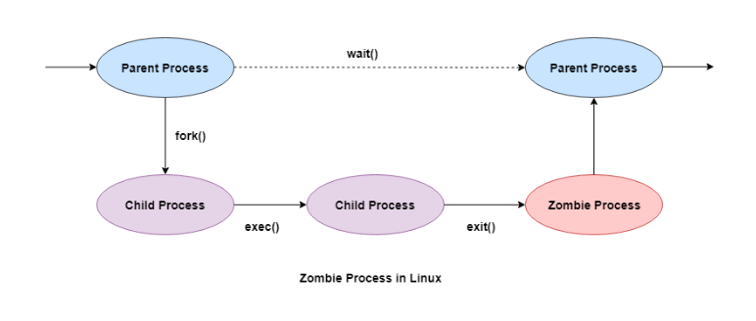
Definition
A zombie process is a process whose execution is completed but it still has an entry in the process table. Zombie processes usually occur for child processes, as the parent process still needs to read its child’s exit status.

Slide 4
Salient points of Zombie Processes
The exit status of the zombie process can be read by the parent process using the wait() system call. After that, the zombie process is removed from the system. Then the process ID and the process table entry of the zombie process can be reused.
If the parent process does not use the wait() system call, the zombie process is left in the process table. This creates a resource leak.
The zombie processes can be removed from the system by sending the SIGCHLD signal to the parent, using the kill command.

Slide 5
Why Zombie Process Created
When a process is created in UNIX using fork() system call, the address space of the Parent process is replicated. If the parent process calls wait() system call, then the execution of parent is suspended until the child is terminated. This state of the child process is known as the Zombie state

Slide 6
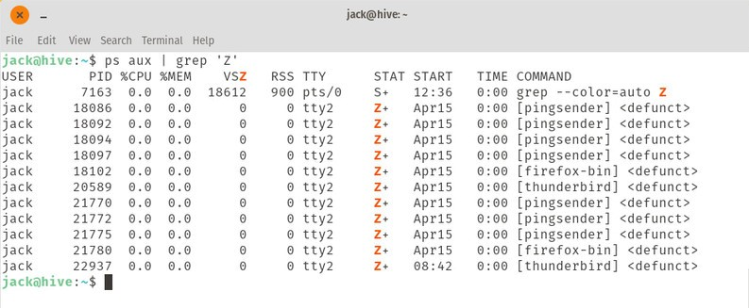
How to Spot a Zombie Process
The first thing to do is to find the zombie process. Pipe the output of the ps command through grep to list out any process whose STAT is Z (for zombie). Open a terminal window and issue the following command:
ps aux | grep 'Z’

Slide 7
How to Kill Zombie Process
Instead of decapitating, burning, or completely dismembering the zombie, we want to use the kill command to end those zombies. The output of the first command will include the PID of all zombied processes, so to kill one of those, you issue the command:
kill PID

Slide 8
Why do we need to prevent the creation of Zombie process?
There is one process table per system. The size of the process table is finite. If too many zombie processes are generated, then the process table will be full. That is, the system will not be able to generate any new process, then the system will come to a standstill. Hence, we need to prevent the creation of zombie processes.

Slide 9
// A C program to demonstrate working of
// fork()/wait() and Zombie processes
#include<stdio.h>
#include<unistd.h>
#include<sys/wait.h>
#include<sys/types.h>
int main()
{
int i;
int pid = fork();
if (pid==0)
{
for (i=0; i<20; i++)
printf("I am Child\n");
}
else
{
wait(NULL);
printf("I am Parent\n");
while(1);
}
}

Slide 10
Conclusion
Finding zombie processes and killing their parents seems easy, but in some cases that might not be the best solution.The kill -9 command (aka kill –SIGKILL ) terminates a program immediately. It might work for some simple processes, however, most processes need to clean up temporary files and wrap up properly before being terminated. As a result of kill -9 there is a risk of unexpected problems, that are difficult to debug. That is why we highly recommend you only use kill -9 if you don’t see any other ways to solve this problem.

